Slide 1
Health Awareness and Nutrition
Department of Clinical Nutrition and Dietetics College of Health Sciences
Lecture 4: Proteins

Slide 2
Introduction
The human body contains an estimated 30,000 different kinds of proteins.
Proteins are more complex than carbohydrates or fats.
They are vital cellular working molecules.
They constitute approximately 20 % of body weight
Proteins are available as:
Working proteins (enzymes, antibodies, hormones, cellular “pumps”…)
Structural proteins (cell membranes, tendons, ligaments, muscles, bones, teeth, hair, nails…)

Slide 3
Proteins
Proteins contain:
Carbon
Hydrogen
Oxygen
Nitrogen
Arranged into amino acids linked in a chain.
Proteins are macromolecules. They are constructed from chains of amino acids (peptides)
Some are much smaller peptides and some much larger (the largest protein found in skeletal and cardiac muscle)

Slide 4
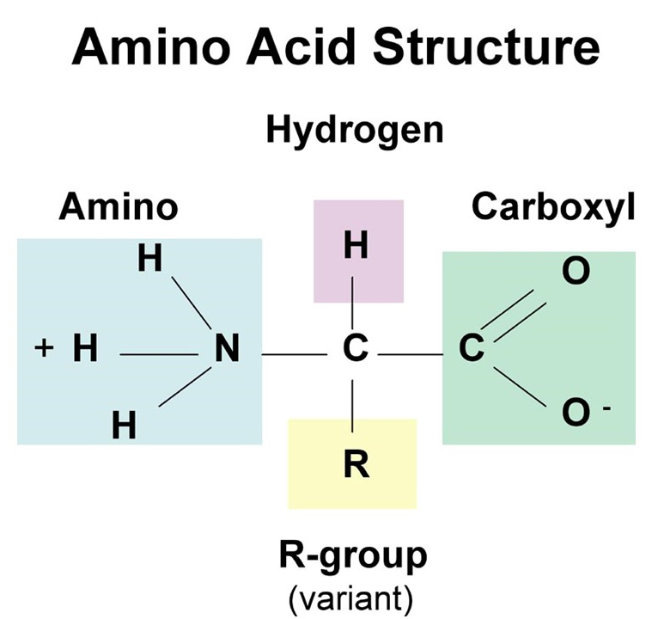
Amino Acids
Amino acids are the building blocks of proteins.
All amino acids have the same base structure:
an amino group
an acid group
a hydrogen atom,
a special side group
all attached to a central carbon atom.
The side groups on amino acids vary from one amino acid to the other
There are 20 different type of amino acid each has a different side group.

Slide 5
Amino Acids
There are 20 different amino acids that occur in nature of which 9 are essential.
Each amino acid has different characteristics.
Essential amino acids
Amino acids
Nonessential amino acids

Slide 6
Amino Acids
Essential amino acids
Nonessential amino acids
Histidine
Isoleucine
Leucine
Lysine
Methionine
Phenylalanine
Threonine
Tryptophan
Valine
Alanine
Arginine
Asparagine
Aspartic acid
Cysteine
Glutamic acid
Glutamine
Glycine
Proline
Serine
Tyrosine

Slide 7
Amino Acids
Essential amino acids
Nonessential amino acids
Indispensable
Cannot be synthesized by the body
Required to be consumed in diet
Dispensable
Can be formed in the body
Conditional amino acids:
They are non-essential amino acids that become conditionally essential until the metabolic pathways are developed to make those amino acids in adequate quantities (e.g. in times of illness, stress or early childhood).

Slide 8
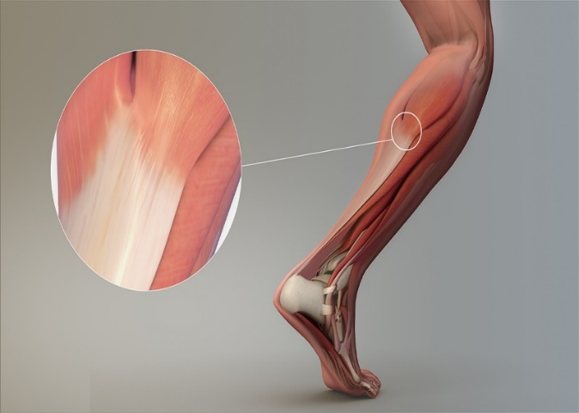
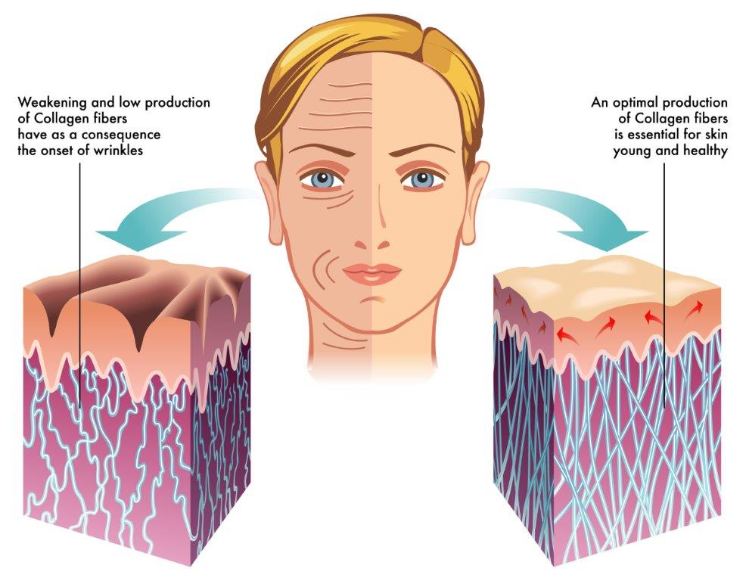
Functions of protein in the body
1. Growth and repair material
Proteins form the building blocks of muscles, blood, and skin.
Important for teeth and bones, and provides material in scar tissue and blood clots, ligaments and tendons.
Proteins are needed for replacing dead or damaged cells.

Slide 9
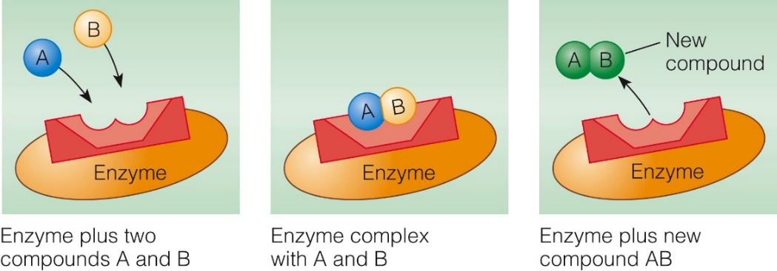
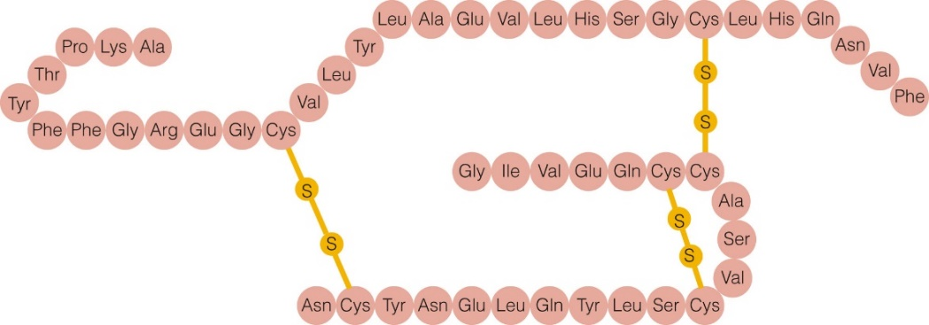
Functions of protein in the body
2. Enzymes
For the regulation of biochemical reactions.
Enzymes break down substances, and build substances (such as bone), and transform one substance into another (amino acids into glucose)
3. Hormones
Messenger molecules.
Many hormones are proteins such as insulin, glucagon and the thyroid hormone.
Transported in blood to target tissues.

Slide 10
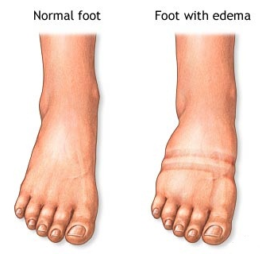
Functions of protein in the body
4. Regulators of fluid balance
Proteins help maintain body fluid and electrolyte balance in two ways:
They attract fluids: Proteins in the bloodstream, the cells, and the space surrounding the cells work together to keep both fluids and electrolytes moving across the space.
They move and retain fluids in the proper quantities to help us maintain both fluid balance and blood pressure.
In protein deficiency, Edema can be observed (disease condition characterized by swelling of body tissues caused by fluid leakage).
Notes:
Fluid balance is attained through maintenance of osmotic pressure (It is the pressure that must be applied to a solution to prevent the inward flow of water across a semi-permeable membrane).

Slide 11
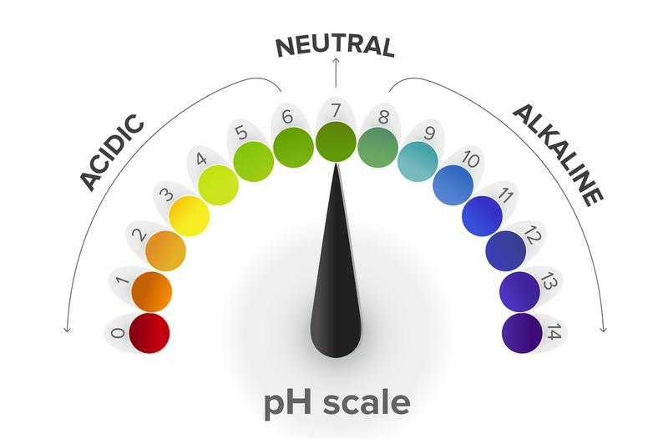
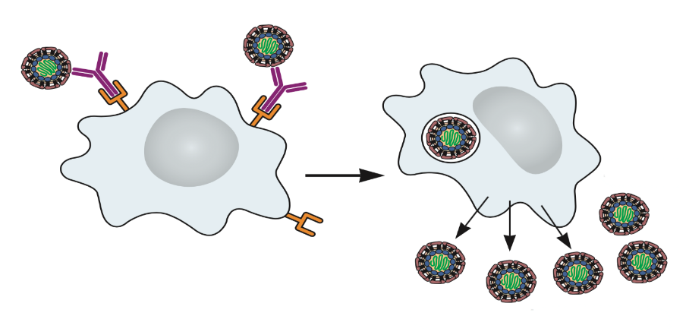
Functions of protein in the body
5. Maintaining acid-base balance
Blood proteins act as buffers in order to maintain the pH conditions of the blood constant.
Acidosis- excess of acid in the body fluids: protein attract hydrogen
Alkalosis- excess of base (alkali) in the body fluids: protein release hydrogen
6. Antibodies
Body defense molecules against foreign substances.
They are proteins produced by the immune system in response to the invasion of the body by foreign molecules.

Slide 12
Functions of protein in the body
7. Source of energy and glucose
Proteins can be used for energy in case there is insufficient fat and CHO
The body will break down its tissue proteins to make amino acids available for energy or glucose production.
In this way, protein can maintain blood glucose levels, but at the expense of losing lean body tissue.
1 g of protein = 4 Kcal
Important note: There is no storage form of protein in the body

Slide 13

Denaturation of proteins
When protein are subject to heat, acid and other condition that disturb their stability, they undergo denaturation.
Denaturation: The change in a protein’s shape and loss of its function from heat, agitation, acid, base, alcohol, heavy metals, or other agents.
Examples
Cooking an egg
Curdling of milk
Stiffening of egg whites

Slide 14
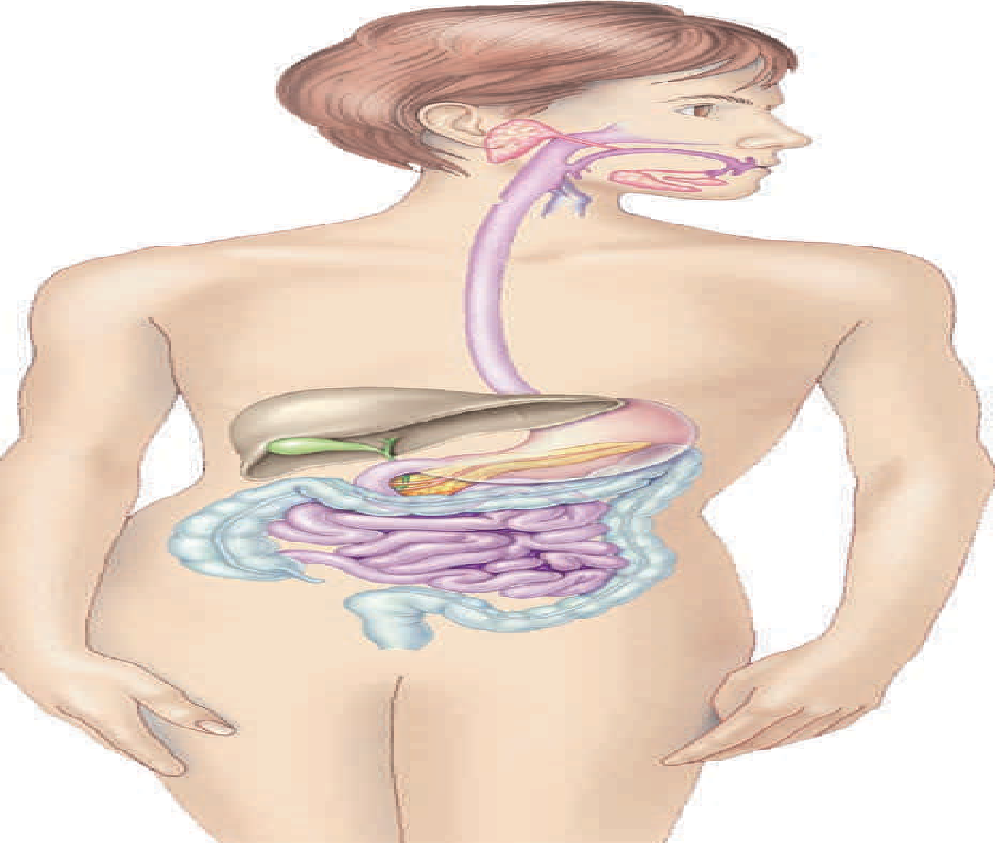
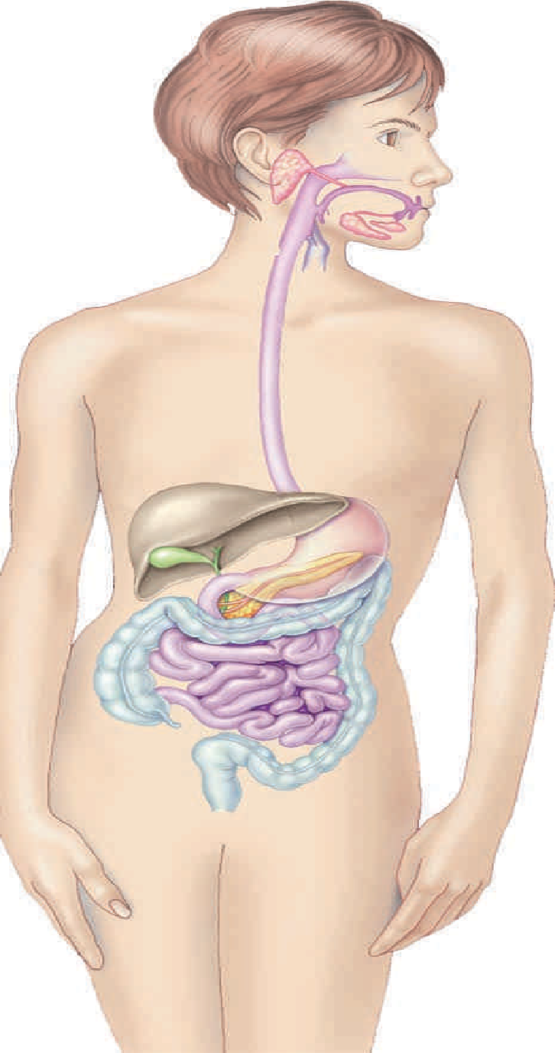
Protein Digestion
No chemical digestion
Proteins are crushed and moistened in the mouth, but the real action begins in the stomach.
Partial digestion
In the stomach:
Partial breakdown (hydrolysis) of proteins by pepsin enzyme.
→ Hydrochloric acid (HCL) in the stomach
Denatures protein
Activates the pepsin enzyme
Protein
HCL (acid)
Pepsin (enzyme)
Smaller molecules (polypeptides)

Slide 15

Protein Digestion
In the small intestine:
→ Hydrolysis reactions (break down of polypeptides)
→ Peptidase enzymes (enzymes in the small intestine)
Peptidases enzymes break down the peptides into amino acids which are absorbed by the villi in the small intestines.
No chemical digestion
Partial digestion
Once the amino acids are absorbed, they are released into the bloodstream, which carries them to the cells in the body for repairing tissue and building muscle
Peptidase enzymes
Peptides
Amino acids
Complete digestion and absorption

Slide 16
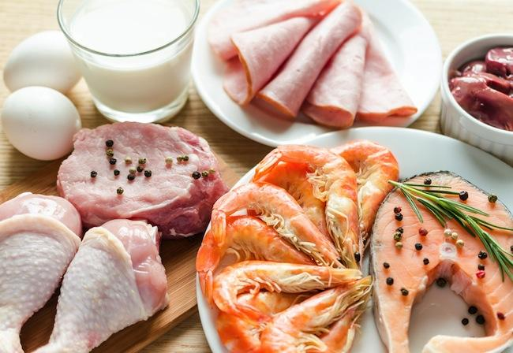
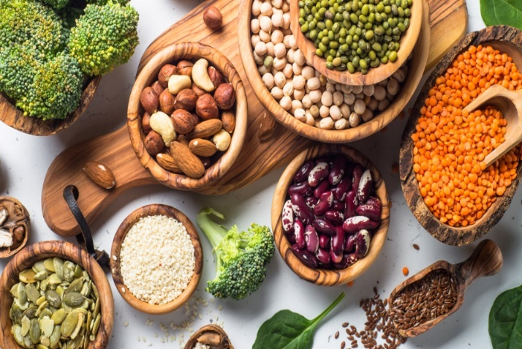
Sources of protein
Animal sources
Plant sources
Milk and dairy,
Meat, Poultry, Fish
(complete proteins)
Pulses, Legumes,
Beans, Nuts, Oil Seeds
(incomplete proteins)

Slide 17
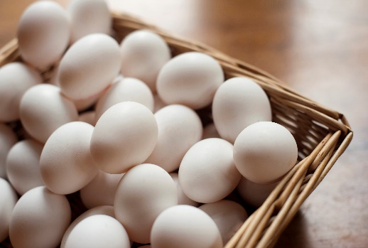
Protein Quality
Determines how well a diet supports the growth of children and the health of adults.
Influenced by:
Protein digestibility
Protein source
Amino acid composition
Essential amino acid consumption

Slide 18
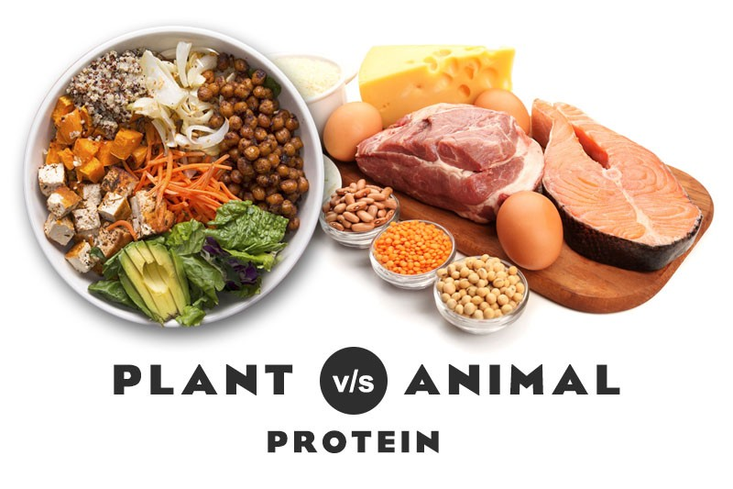


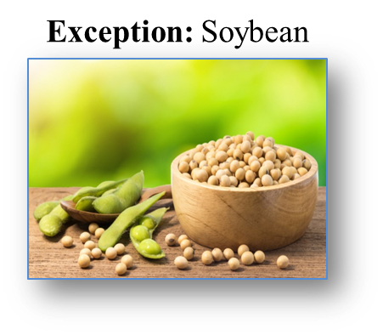
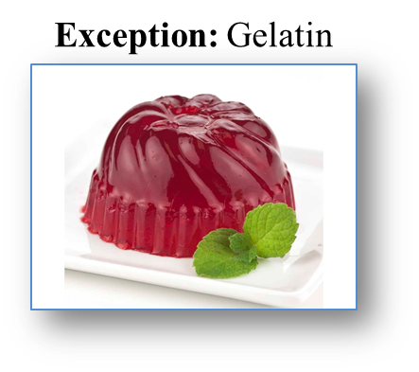

Protein Quality
Plant Proteins
Low digestibility/quality
Don’t contain all the essential amino acids
Incomplete proteins
Exception: Soybean
Animal Proteins
High digestibility /quality
Contain all the essential amino acids
Complete proteins
Exception: Gelatin

Slide 19
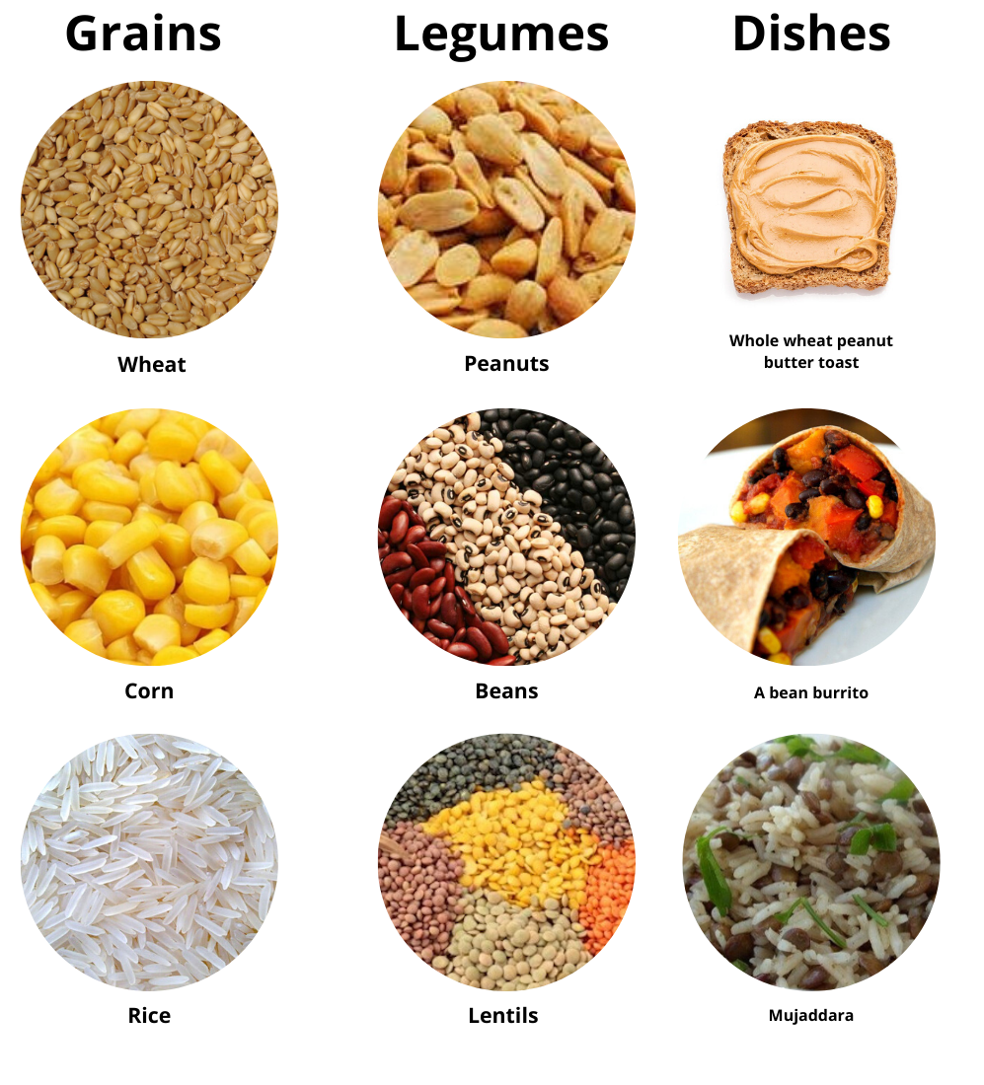
Protein Complementation
Protein quality is of utmost importance in poor countries where people rely on plant proteins as the main source of proteins in the diet.
The concept of complementation: plant proteins can provide enough amounts of all essential amino acids when combined to complement each other.
→The essential amino acids missing from one are supplied by the other
 | Ile | Lys | Met | Trp
Legumes | ✓ | ✓
Grains |  |  | ✓ | ✓
Together | ✓ | ✓ | ✓ | ✓

Slide 20


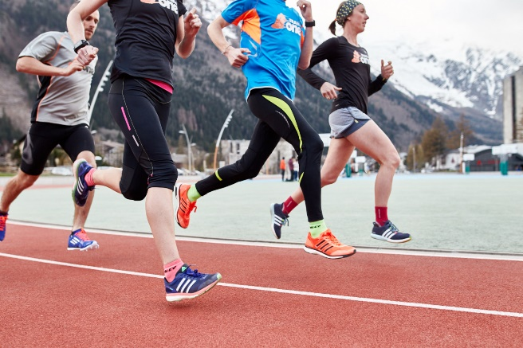
Body Protein Needs
Protein recommendations for infants, growing children, and pregnant and lactating women and athletes are somewhat higher than those for the general population.
Even athletes in training do not typically need to increase their protein intakes because the additional foods they eat to meet their high energy needs deliver protein as well.

Slide 21


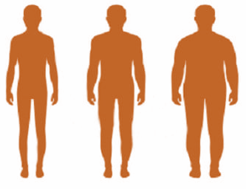


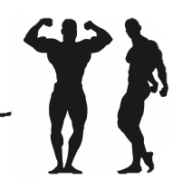

Body Protein Needs
Depends on
Adults
Age: requirements decrease with age
Body size: increase with body size/weight
Pregnant and lactating women: higher than other adults
Sick or immuno-compromised: higher
Infants and growing children: recommendation is higher
RDA for Adults:
0.8g/kg/day
10-35% of total daily calories
Body builders
RDA for body builders:
1- 2 g/kg/day
Notes:
RDA:Recommended Dietary allaowances

Slide 22
Health Effects of Protein
Protein deficiency
Adults bone loss (osteoporosis)
Protein-energy malnutrition
Marasmus and kwashiorkor
Increase in calcium excretion
Protein-to-calcium ratio
Heart disease
Weight control
Animal-protein intake
Hight protein diets
Cancer
Kidney disease
Protein-rich foods such as red meat and processed meat; not protein content of diet
Acceleration of kidney deterioration

Slide 23
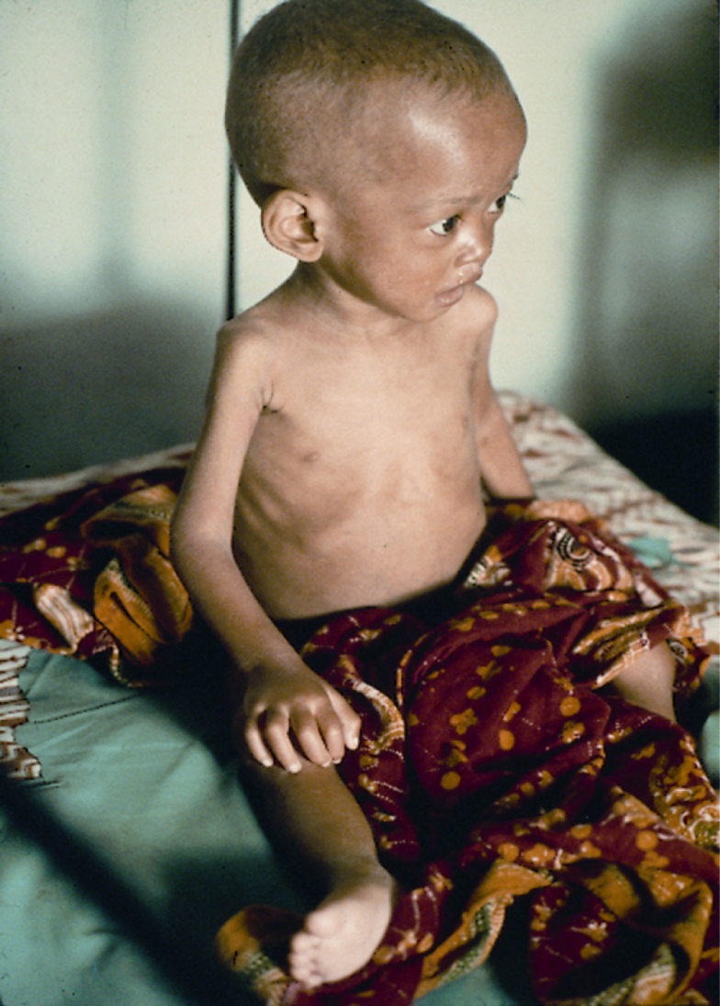
Protein Energy Malnutrition
When people are deprived of protein, energy, or both, the result is Protein-Energy-Malnutrition (PEM). It is the most widespread form of malnutrition in the world today.
PEM strikes early in childhood: Marasmus and Kwashiorkor
PEM can touch many adult lives as well: AIDS, Cancer patients, Alcoholics, drug addicts, etc.

Slide 24
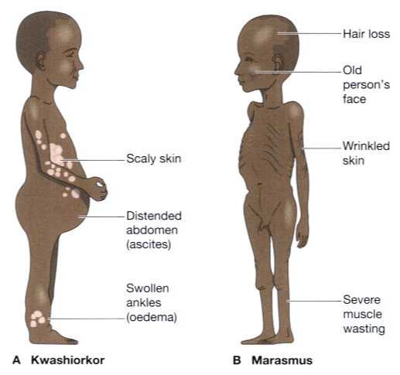
Protein Energy Malnutrition
A. Kwashiorkor
Too little protein to support body functions
Swollen belly and skin rash are present
Risk of infection
Severe acute malnutrition
Happen when weaning the baby in developing countries
B. Marasmus
Chronic inadequate food intake
Muscle wasting (heart failure)
Inadequate energy, vitamin, mineral, and protein intake
Person is shriveled and lean all over

Slide 25
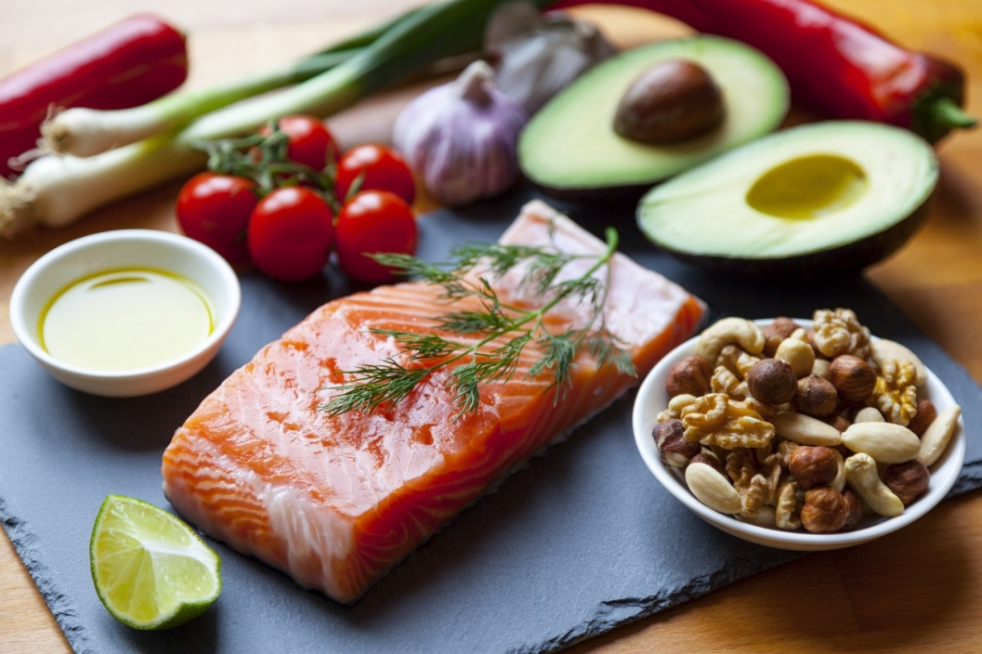

High Protein Diets
High protein diets are being used to induce rapid weight loss, however excess protein intake (more than twice the RDA) is associated with many health risks:
Associated risks:
Increased blood acidity (Ketosis)
Kidney stones & renal failure
Cardiovascular disease (high in saturated fat)
Osteoporosis
Decreased vitamins, minerals, and fiber intake

Slide 26
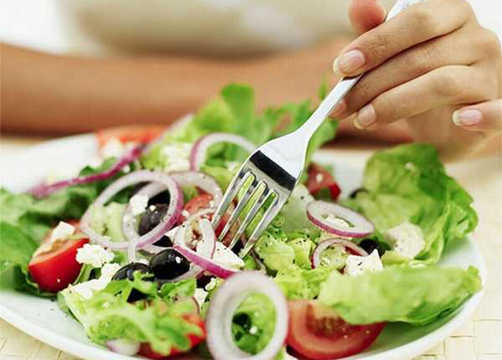
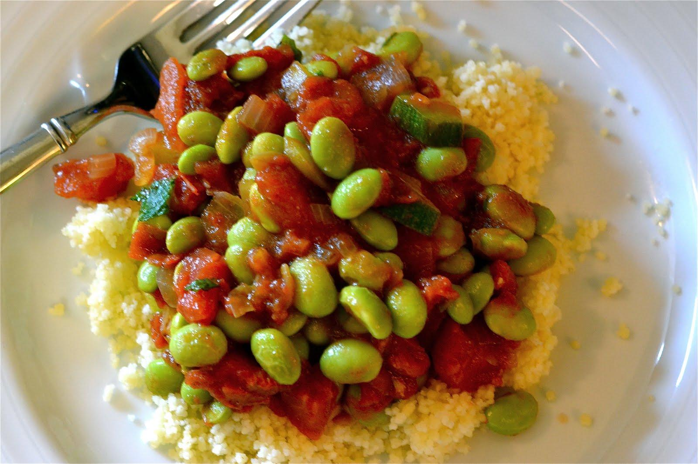
Vegetarian Diets
People who opt to become vegetarian can still meet their daily protein requirement by carefully planning their meals and by knowing about protein complementation.
Vegetarian diets are often characterized by:
Lower fat, cholesterol and calorie intake
Increased vitamins, antioxidants and fiber intake
Positive health aspects:
Lower incidence of obesity & Cardiovascular diseases(CVD)
Lower blood pressure
Lower incidence of diabetes
Lower cancer risks
Lower incidence of constipation

Slide 27
Info for your interest

Slide 28
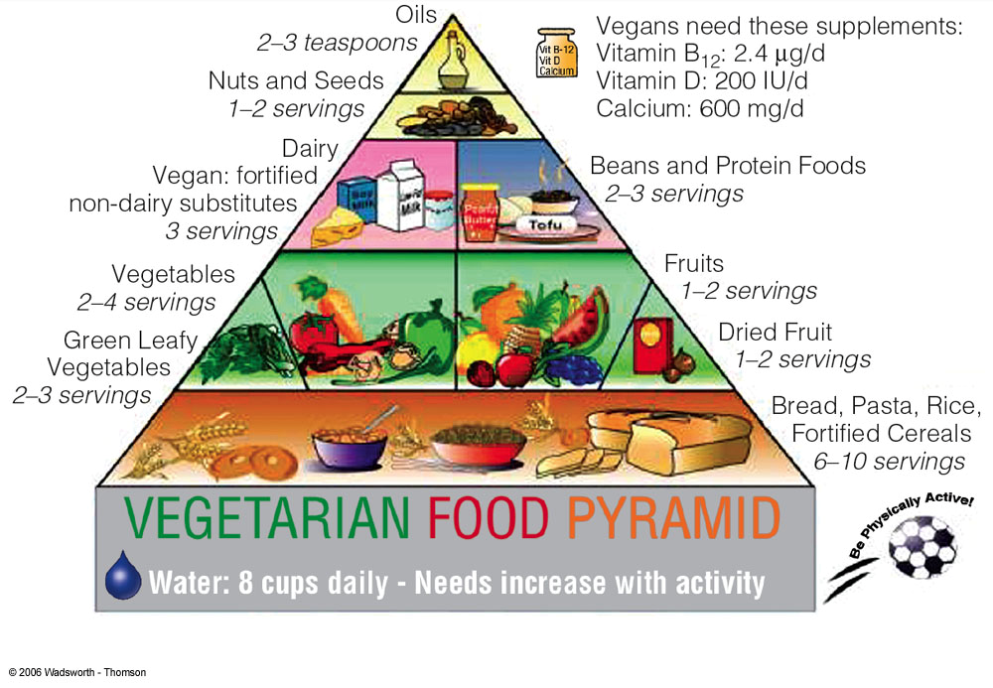
Vegetarian Food Pyramid

Slide 29
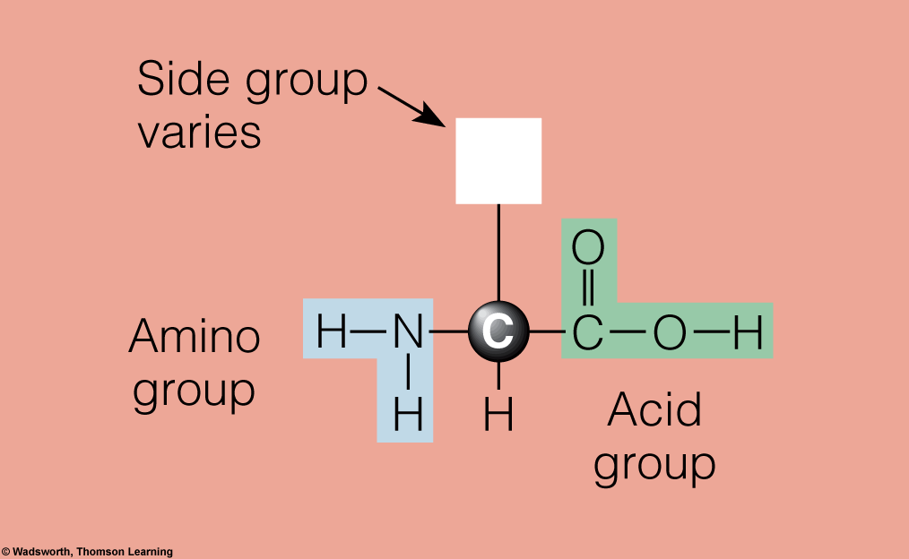
Amino Acids

Slide 30
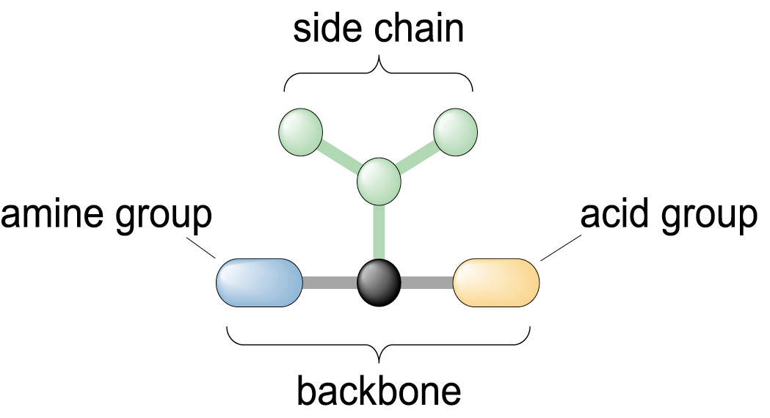
Amino Acids
Each AA contains:
- an amine group at one end (nitrogen – containing part)
- an acid group at the other end (COOH)
- a distinctive side chain
Side chain differs in size, shape and electrical charge → gives identity and chemical nature to each AA

Slide 31
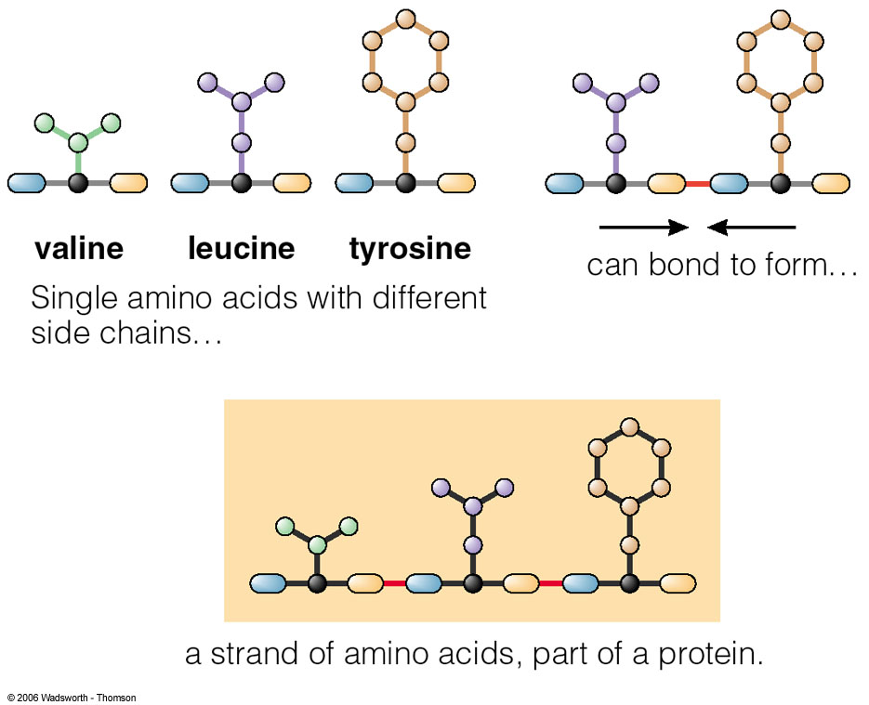
Amino Acids

Slide 32
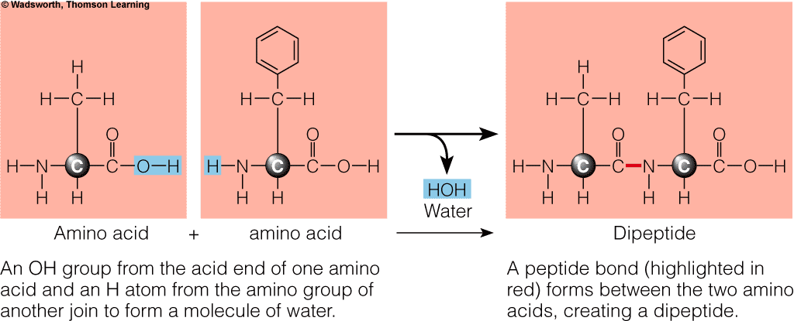
Proteins: Composition
Notes:
Fluid balance is attained through maintenance of osmotic pressure (It is the pressure that must be applied to a solution to prevent the inward flow of water across a semi-permeable membrane).

Slide 33
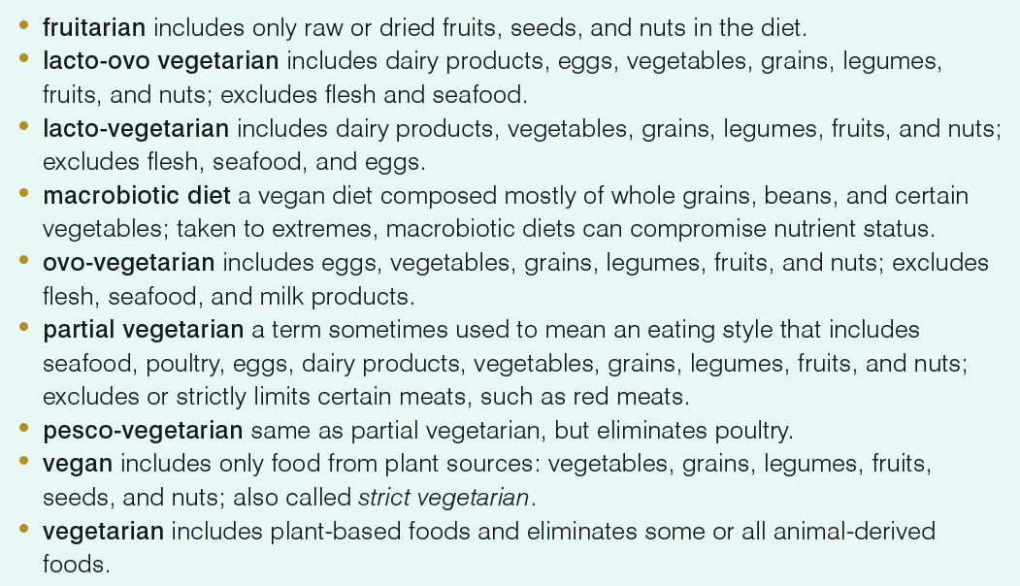
Terms Used to Describe Vegetarians and Their Diets

